Slide 1
The purpose of this deck is to fulfill the requirement of DSI 39, Project 4.
Role: Health Promotion Board (HPB) Data Science Team
Audience: HPB's Senior Management
Problem Statement: Singaporeans spend a significant % of their diet on snacks. However, there is no guidelines that apply specifically to snacks.
Done by: The Colony (Jackie Seah, Li Cheng, Mei Qi, Yvonne Lim)

Slide 2
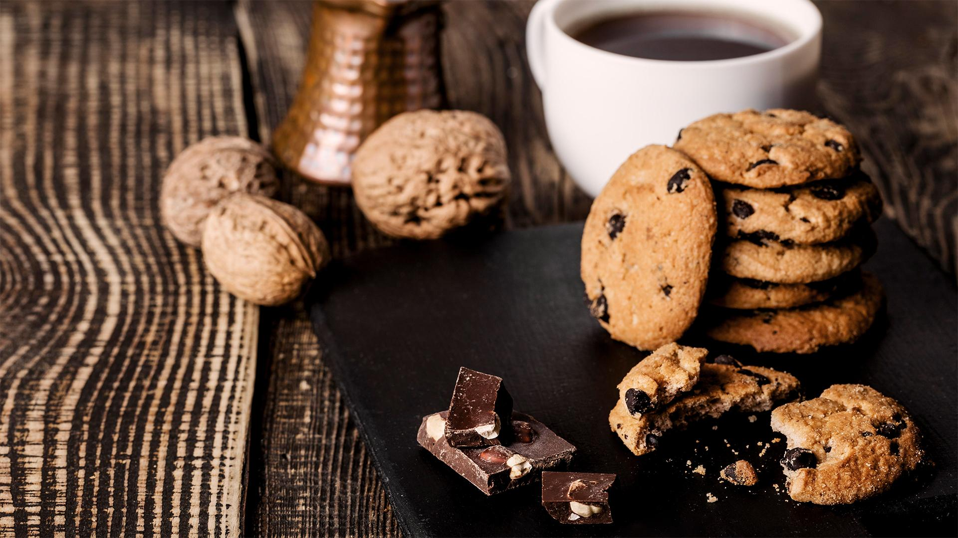
Snack-O-Meter: a tool to inform consumers on consumption of biscuits
HPB Senior Management Meeting (13 Oct 2023)

Slide 3

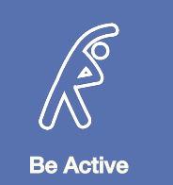


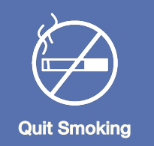
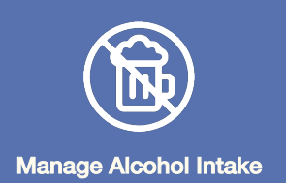

The National Population Health Survey highlighted need to focus on healthy diets and lifestyles
Notes:
Encouraging residents to adopt healthier diets

Slide 4
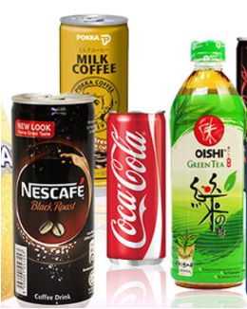
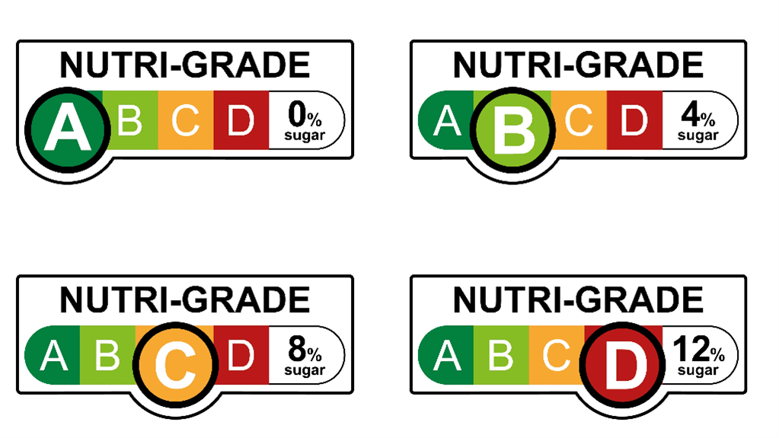
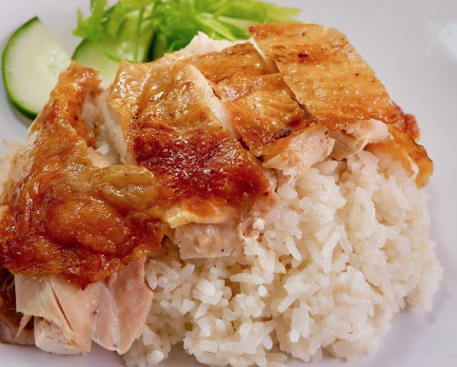

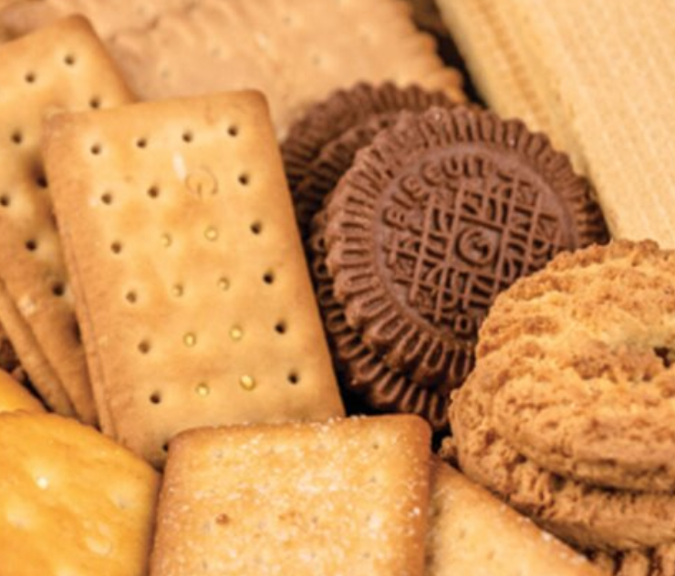
Beverages
- Focuses on Sugar and Saturated Fat
- Nutri-Grade shifted consumption patterns and sugar intake has reduced
Singaporeans’ diet is showing an increasing
consumption of fats, sodium, and sugar. While there are ongoing efforts to promote healthy consumption of beverages and food dishes, there is a gap in covering the nutritional values in snacks.
Food Dishes
- Focuses on Sodium
Singapore is studying possible regulatory measures to reduce sodium content in food
Snack
- Focuses on Sugar, Sodium and Fat

Slide 5
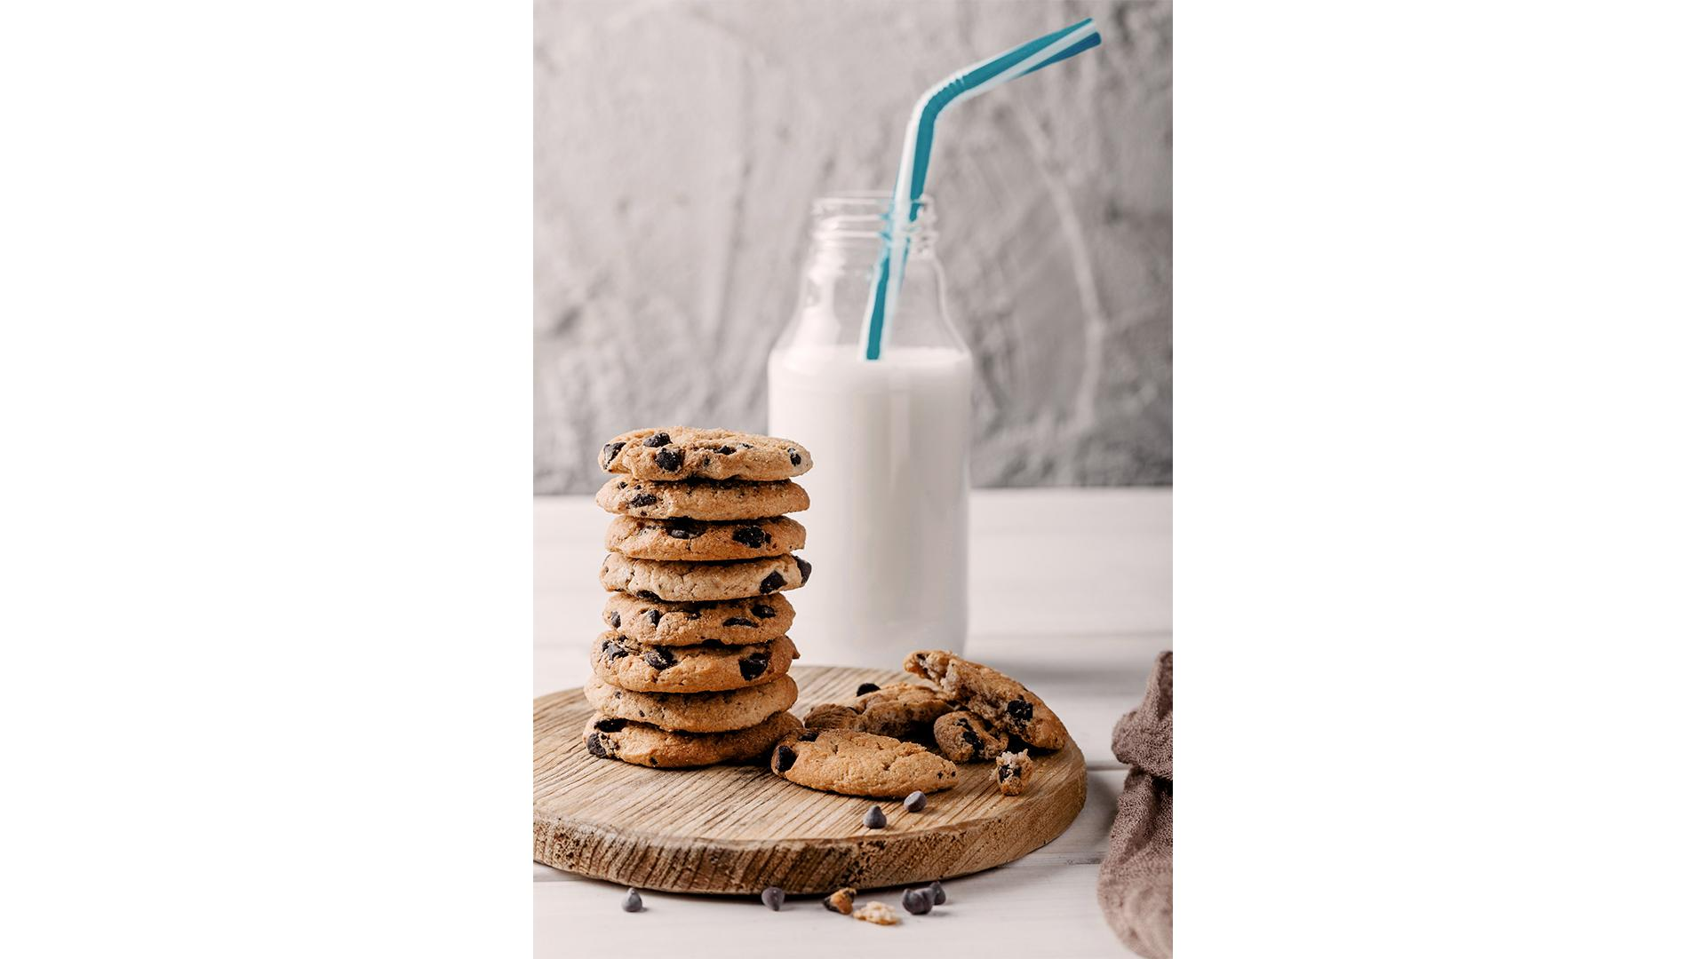
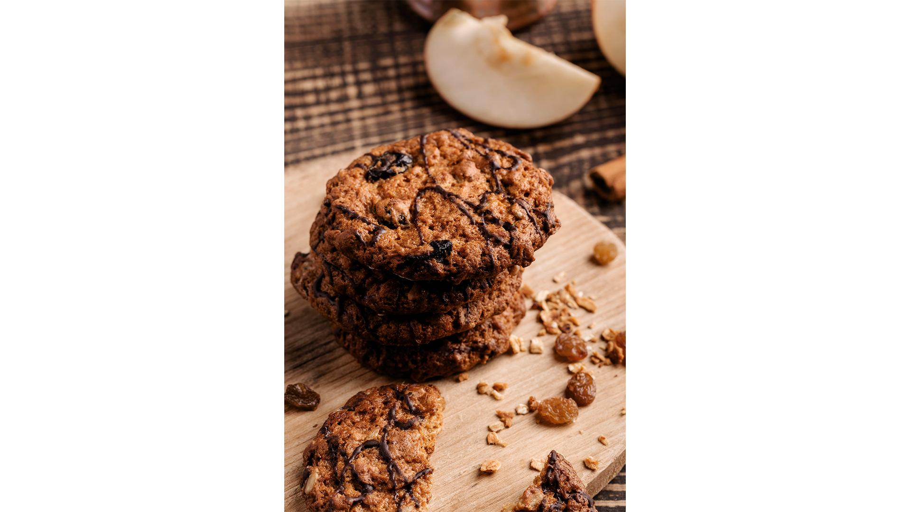
Biscuit is used as the initial proof-of-concept due to its popularity.
Leading choice of snacks
Market Size
57%
5%
Survey respondents purchased biscuits over other snacks
Expected CAGR in the next 5 years
https://www.statista.com/forecasts/1231123/snack-food-market-volume-by-segment-worldwide
https://www.statista.com/statistics/1341575/singapore-most-bought-sweet-snacks-in-the-past-week/

Slide 6
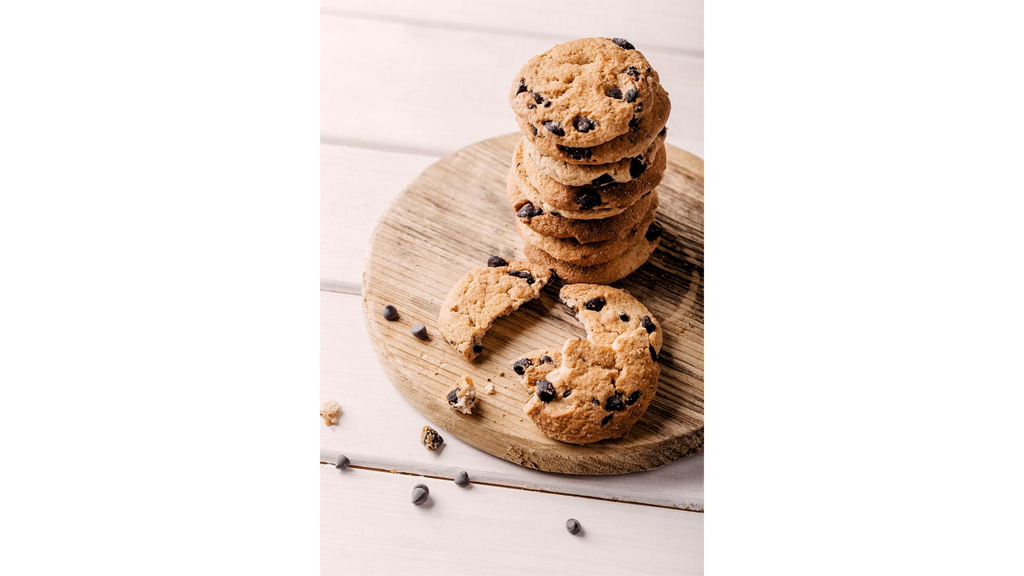
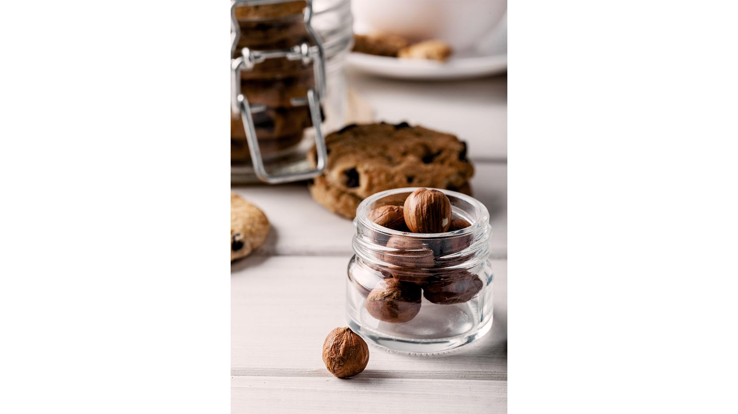
Objective
To build a user-friendly tool that can classify if a biscuit is healthy or not, helping consumers make healthier choices
Cookie shop

Slide 7
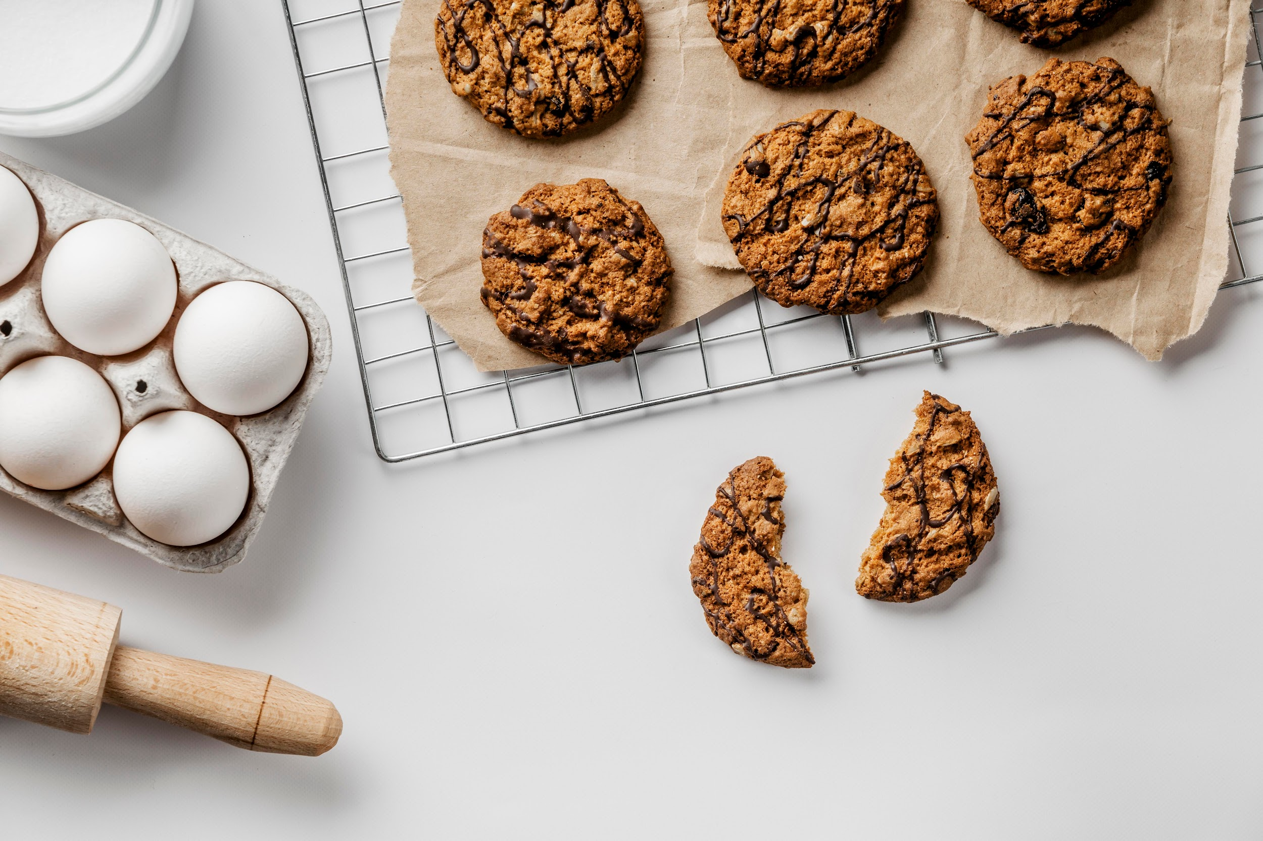
Workflow
Web-scraping
Scraping biscuits and their nutritional data from Fairprice website.
Data Cleaning and Labelling
Using regular expressions to extract information from the unstructured data.
Modelling
Fitting and evaluating multiple classification models to classify “healthy” vs “unhealthy” based on its nutritional values.
Labelling “healthy” vs “unhealthy”
Web Application Design
Developing a user-friendly web application for consumers and businesses to use

Slide 8

Variations in nutrients within each type and among the types call for need to consider a combination of the nutrient amount
Cream-filled biscuit has the highest amount of fats
Chocolate cookies has the highest amount of sugar
Cracker has the highest amount of sodium
Fats | Sugar | Sodium
Chocolate cookies
Cracker
Cream filled biscuit
Wafer
4
4
4
3
3
3
2
2
2
1
1
1
4
4
4
3
3
3
2
2
2
1
1
1
4
4
4
3
3
3
2
2
2
1
1
1
4
4
4
3
3
3
2
2
2
1
1
1
1 refers to lowest amount of the component, and 4 refers to the highest amount of the component, in the biscuit type, where amount is based on the median value of each biscuit type
Notes:
Based on the median values, chocolate cookie has the lowest fat per 1g of serving, followed by cracker, then wafer, and cream biscuit has the highest fat. This could be due to the cream filling contributing to additional amount of fats on top of the butter that is a common ingredient in biscuit.
Based on the median values, cracker has the lowest sugar per 1g of serving, followed by cream biscuit, then wafer, and chocolate cookie has the highest sugar. This could be due to the chocolate contributing to additional amount of sugar on top of the sugar that is a common ingredient in biscuit.
Based on the median values, wafer has the lowest sodium per 1g of serving, followed by chocolate cookie, then cream biscuit, and cracker has the highest sodium. Crackers are known to be savory biscuits compared to the other types of biscuit, and this could be explained by the high level of salt present in crackers.
The level of fat, sugar and sodium varies within each biscuit type, as well as among different biscuit type. It will be challenging to inform consumers on whether a biscuit is healthy or not based on just the type. Hence, the project seeks to classify if a biscuit is healthy or not based on the 3 nutrients using a rule based approach.

Slide 9
Variations in nutrients within each type and among the types call for need to consider a combination of the nutrient amount
Cream-filled biscuit has the highest amount of fats
Chocolate cookies has the highest amount of sugar
Cracker has the highest amount of sodium
Fats | Sugar | Sodium
Lowest amount of total fats, but highest amount of sugar
Chocolate cookies
Cracker
Cream filled biscuit
Wafer
4
4
4
3
3
3
2
2
2
1
1
1
Lowest amount of sugar, but highest amount of sodium
4
4
4
3
3
3
2
2
2
1
1
1
4
4
4
3
3
3
2
2
2
1
1
1
4
4
4
3
3
3
2
2
2
1
1
1
1 refers to lowest amount of the component, and 4 refers to the highest amount of the component, in the biscuit type, where amount is based on the median value of each biscuit type
Notes:
Fats: butter, oil.

Slide 10
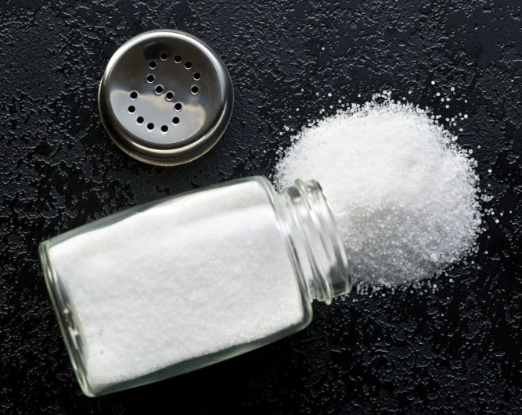
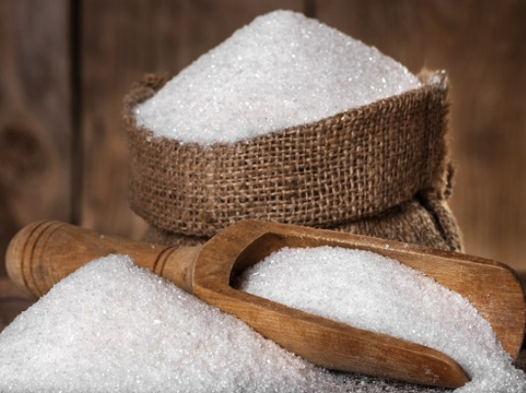
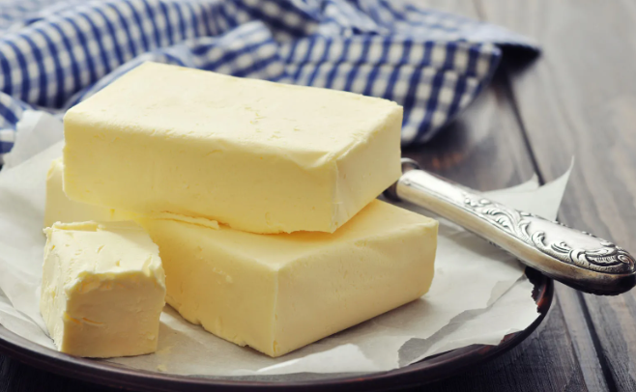
Labelling biscuits based on recommended values of 3 nutrients of concern
Sodium
Sugar
Fat
0.28g/100g
21g/100g
25g/100g
Sugar and Fat based on Healthier Choice Symbol Nutrient Guidelines (as of 2020)
Notes:
LC start here

Slide 11

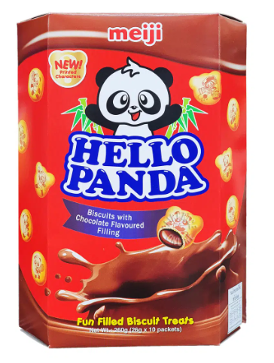
A classification machine learning model is trained, and used to classify if a biscuit product is healthy or unhealthy
Data preparation
- Split data
- Upsample imbalanced train data
Training models
Model Evaluation
- Accuracy
- Under/Over-Fitting
- Run Time
Biscuit | Fat | Sodium | Sugar | Predictor
A | X | X | X | Healthy
B | X | X | X | Unhealthy
C | X | X | X | Healthy
Best model
Tuning
Deploy best model
Healthy: Eat in Moderation
OR
Unhealthy: Eat Less Of

Slide 12
Models Used
Model Evaluation
Logistic Regression
A statistical model that models the probability of an event taking place by fitting a sigmoid function to the data.
Decision Tree
A machine learning algorithm that constructs a tree-like structure which represents a series of decisions and their possible consequences.
Decision Tree (with bagging)
Multiple decision trees (dataset is randomized) are used to make a single prediction.
Random Forest
Multiple decision trees (both dataset and features are randomized) are used to make a single prediction.
Accuracy
The total number of accurate predictions out of all predictions. The higher the better.
Cross Validation Accuracy
The accuracy of the model based on different subsets of the dataset. It should be close (within 10%) to the train and test accuracy. This suggests that the model is generalizable and will show similar performance on unseen data.
F1 Score
Harmonic mean of the precision and recall scores of a model. The higher the better.
Run Time
Time taken to train the model. The lower the better.

Slide 13
Decision Tree is the best performing model which takes the shortest time to run
Models​ | Train accuracy​ | Test accuracy​ | Cross Validation Train accuracy | Train F1 score | Time Taken to run (in secs)
Logistic Regression | 0.77 | 0.86 | 0.66 | 0.77 | 0.06
Random Forest | 1.00 | 1.00 | 0.92 | 1.00 | 1.53
Decision Tree | 1.00 | 1.00 | 0.95 | 1.00 | 0.03
Decision Tree with Bagging | 1.00 | 1.00 | 0.92 | 1.00 | 0.22
Notes:
LC ends here

Slide 14
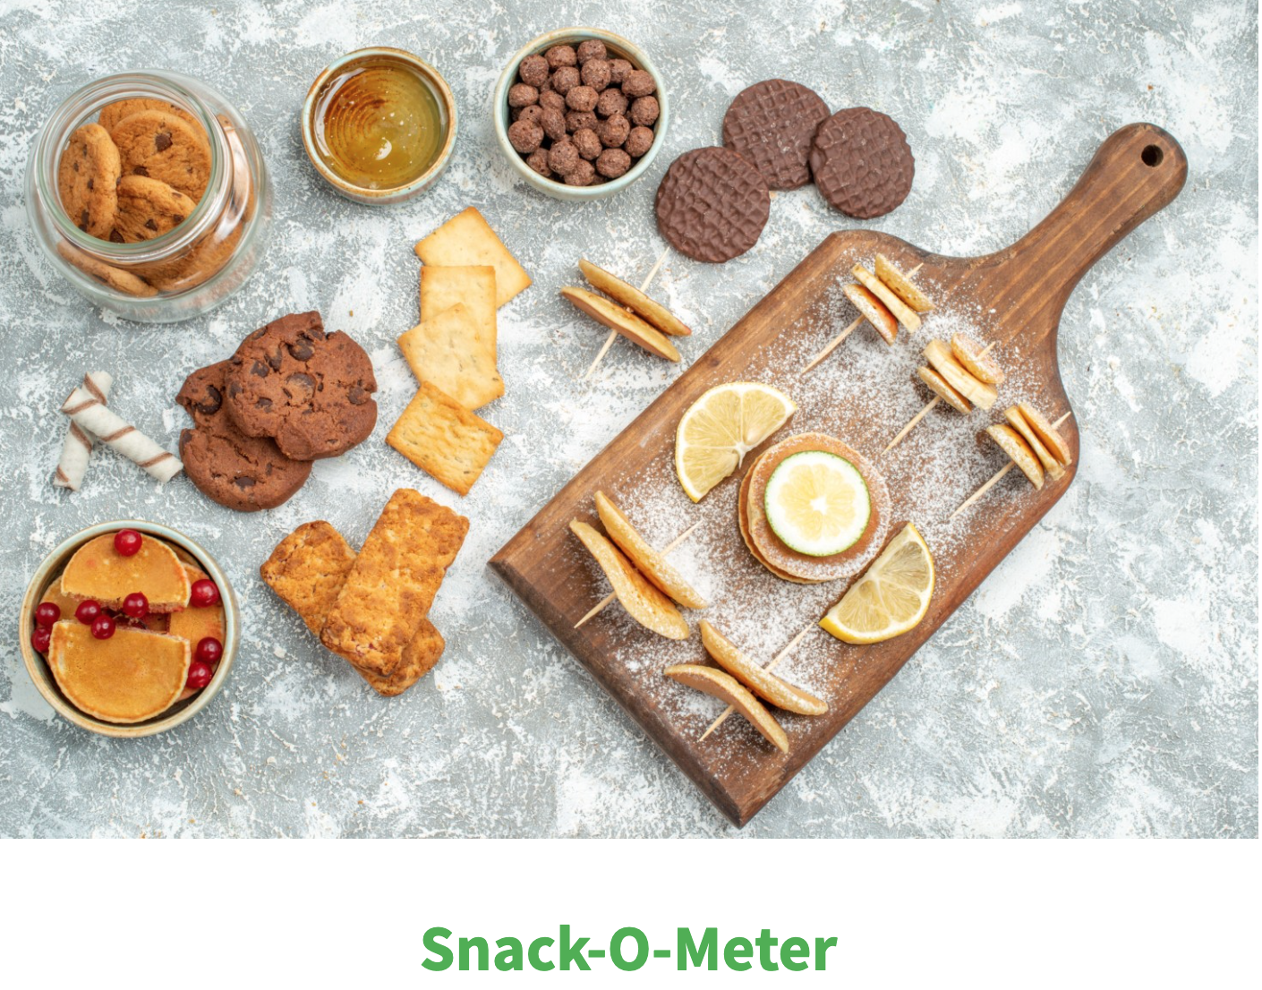
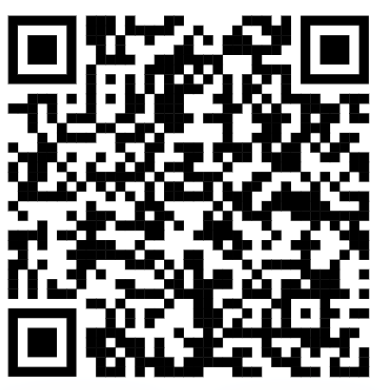

DEMO
Snack-O-Meter
https://snack-o-meter.streamlit.app/
Notes:
Yvonne demo

Slide 15

Recommendations
Increase Awareness to Public
Expand the model to include other snack types
Integrate tool into HPB’s existing Health 365 app
Through marketing campaigns (offline and online campaigns)
Other snack types like nuts, chips.
Intergration is beneficial as it makes Health 365 as “one stop app”
Notes:
Jackie start here

Slide 16

Cost (estimated per year)
Benefit of tool overweighs cost by 25x
$500,000
$12,840,000
Benefit (estimated per year)
Marketing Campaign:
S$400,000
App Development & Maintenance:
S$100,000
Healthcare cost of metabolic risk: S$642,000,000
Reduction of daily sodium, sugar, fats consumption:
2.0%
In FY2022, HPB spent $400k on Programme, supplies & marketing.
From FY2017 to FY2019, the median sugar level of beverages decreased from 8.5 to 6.3 grams per 100 ml (25%) due to the Nutri-Grade campaign.
Assuming one consumed a serving of Hello Panda Chocolate a day, that would constitute 8% of the daily average fats, sodium and sugar intake overall.
All else constant, if this label has the same success as the Nutri-Grade campaign, it can reduce daily fats, sodium and sugar intake by 2%.

Slide 17
Summary
Problem statement:
Singaporeans’ diet is showing a worrying trend of increasing consumption of fats, sodium, and sugar. While there are programs in place to mitigate those, there is a gap in covering snacks, which is a significant part of Singaporeans’ diet.
Deliverables:
Build a classifier model with accuracy of > 0.9
Deploy an easy-to-use self-help tool using the classifier model to provide quick information for individuals to improve their snacking habits

Slide 18
Thank You.

